Slide 1
Discussion 9: Heaps of Hashing
Christine Zhou

Slide 2
Agenda
Announcements
Heaps
Problem 1
Hash tables
Problem 2
Hash Codes
Problem 3

Slide 3
Announcements
Mid-semester survey due this Friday
Less time to work on the problems by yourself
Goes a little too slowly
Don’t really need to talk to each other to discuss the problem
Make sure to go through the harder problems
Midterm coming up next week
Start studying early!
Advising sessions are updated weekly!
tinyurl.com/cs61b-advising
Project 2
Take a look at spec for extra credit opportunities!
Start early! We’ll have extra office hours just like we did for Proj1
Refetch from shared to get an updated col/row

Slide 4
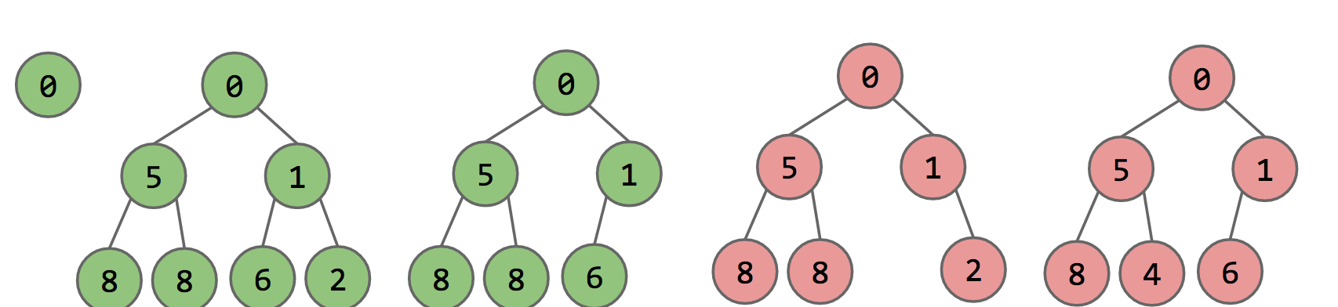
Heaps
Sometimes we want to prioritize elements in a certain way, always get the minimum
Use a heap!
Complete: missing items only at the bottom level and pushed as far left on the bottom level as possible
(Min/Max) heap property: every node’s value is (less/greater) than or equal to its children’s value

Slide 5
Common Methods of Heaps
Insert
Put new item in first free bottom leftmost position, then bubble up
removeMin/removeMax
Replace root item with the bottom rightmost item, then bubble down the root
getMin/getMax
Return the value at the root

Slide 6
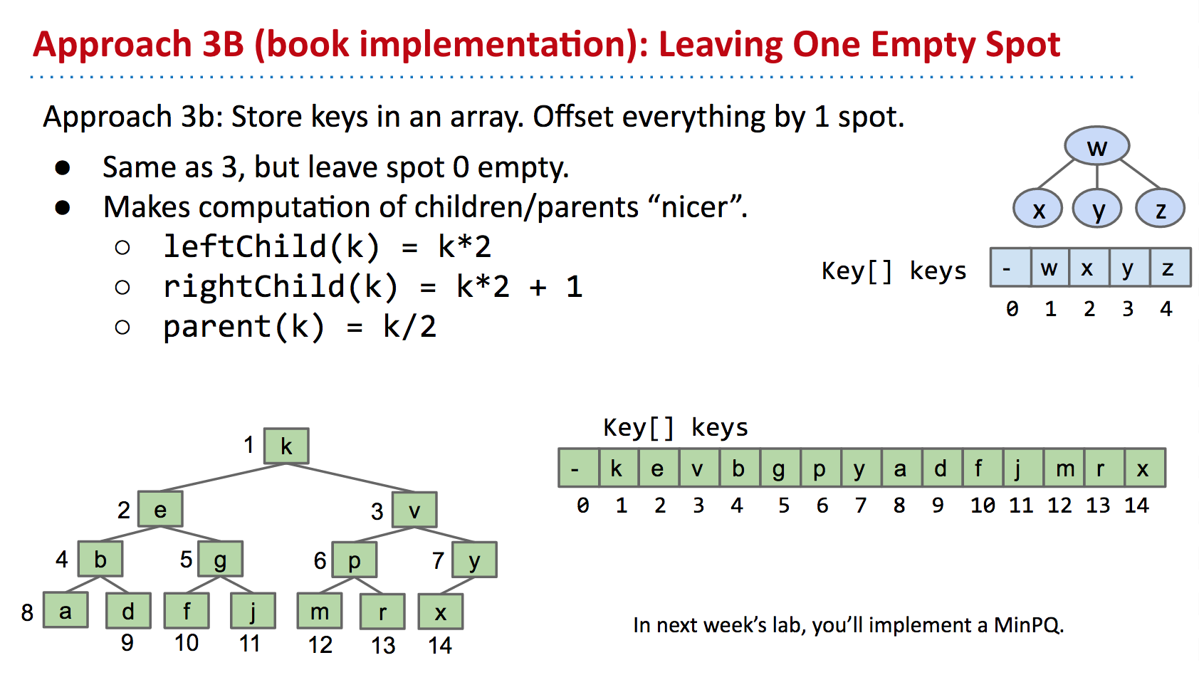
How do we represent heaps?

Slide 7
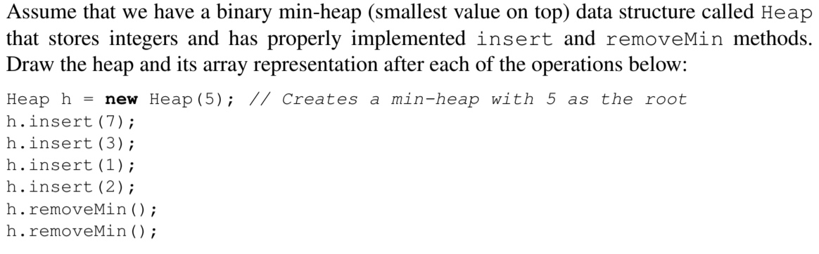
1 Heaps of fun

Slide 8
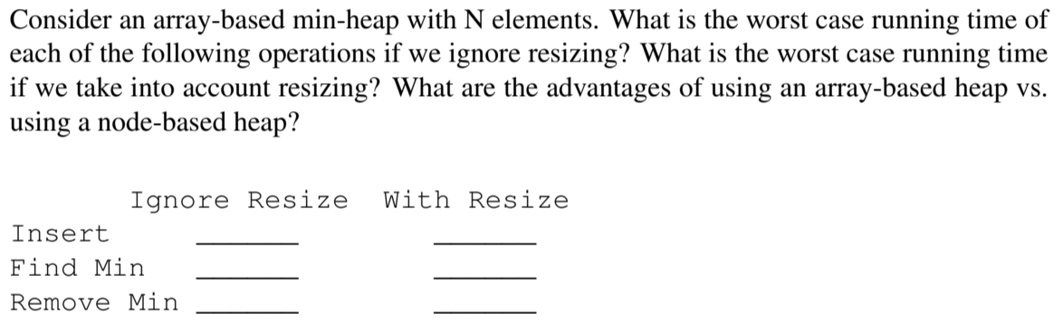
1 Heaps of fun

Slide 9
HashMaps
Use an array to represent your data
For each key-value pair, assign each key a “hash code”
mod (%) the hash code by the length of the array (this gives you a number between 0 and array.length - 1), use this as the index!
Be careful about negative numbers when modding!
N = num elements, M = num buckets, C = some constant
If N/M > C, then increase M!
N/M is called the load factor
If we have multiple elements that go to same place in the array, usually we will keep track of a list
This is called external chaining
What is the runtime of .contains and .insert?

Slide 10
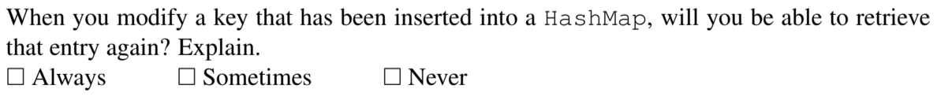
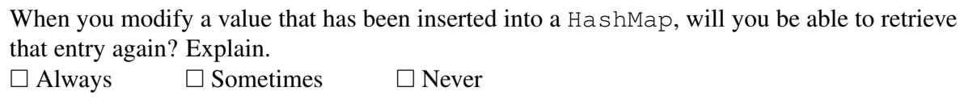
2 HashMap Modification

Slide 11
Hash Codes
What is necessary for a valid hash code?
If A.equals(B) is true, then A.hashCode() == B.hashCode()
The opposite is not necessarily true
What is necessary for a good hash code?
Spread things out nicely/evenly in our hash table
Default: use Object class’s hashCode method
Returns the address of the object
We can override this method

Slide 12
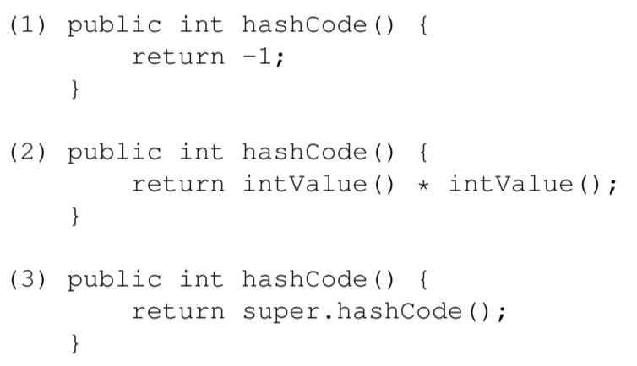
3 Hash Functions
Here are three potential implementations of the Integer’s hashCode() function. Categorize each as either a valid or an invalid hash function. If it is invalid, explain why. If it is valid, point out a flaw/disadvantage.
Note: A “valid” hashCode() means that any two Integers that are .equals() to each other should also return the same hash code value.
Another note: the Integer class extends the Number class, a direct subclass of Object. The Number class’ hashCode() method directly calls the Object class’ hashCode() method.

Slide 13
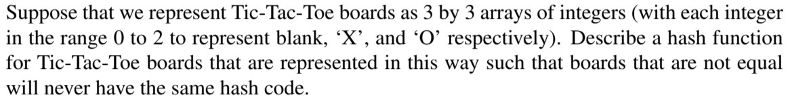
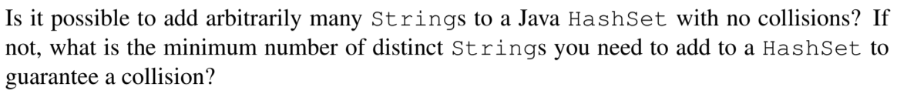
3 Hash Functions

